Slide 1










LONDON AIRBNB
DATA-230 SEC-11 DATA VISUALIZATION
Presented by: GROUP 5
Notes:
"Good evening, we're Group 5, and our project is about London Airbnb listings."
"Our question is simple: what makes a listing top rated?"

Slide 2









MEET Our LONDON DATA CREW
Priya
  Varuna
  Sanjana
  Ngoc
Notes:
"We're Priya, Varuna, Sanjana and Ngoc."
"Each of us owned one part of the analysis, and you'll hear from all of us today, plus a dashboard demo."

Slide 3
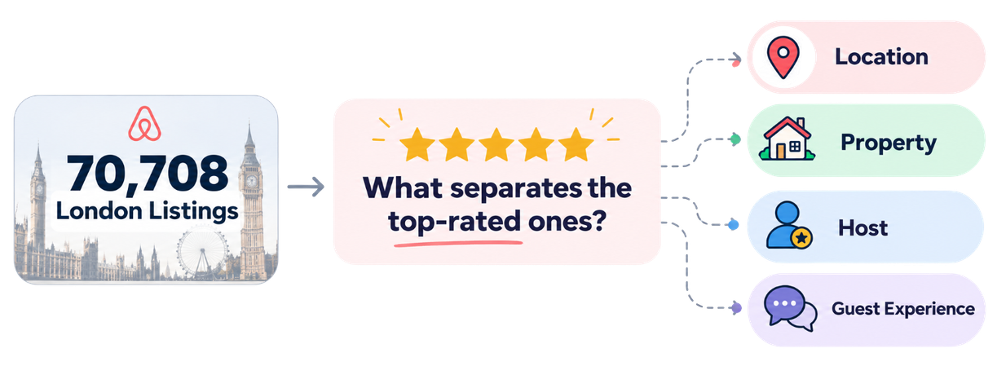
Research Question:
WHAT MAKES A LONDON AIRBNB TOP-RATED - 4.8+?
And what can hosts learn from the listings that get it right?
Our goal: Turn 70,708 listings into actionable insights for London Airbnb hosts
Notes:
"Our research question: what makes a London Airbnb top rated, meaning 4.8 stars or higher?"
"And the practical side: what can hosts learn from the listings that get it right?"
"Our goal is to turn 70,708 rated listings into advice a host can act on."

Slide 4

Analysis journey
OUR ROADMAP TO THE ANSWER
THE MARKET
THE HOST
  THE LOCATION
THE LISTING
THE ANSWER
What does
London Airbnb look like?
Does the host behind the listing matter?
Where are highly rated listings concentrated?
Which property and listing features move together with ratings?
What should a host focus on?
Notes:
"We answer it in steps: first the market, then the host, the location, and the listing itself."
"Each step feeds the next, and at the end we bring it together into what a host should focus on."

Slide 5
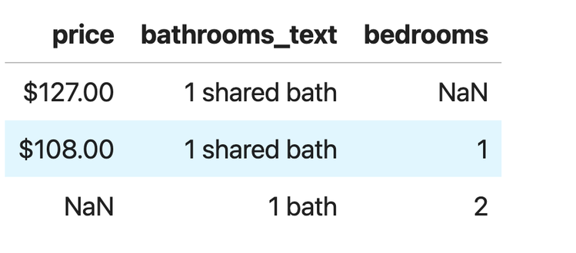
Dataset overview
92,638 LISTINGS: WHAT EARNS A 4.8+?
92,638
LISTINGS
90
COLUMNS
56%
TOP RATED
SOURCE
Inside Airbnb, London
Snapshot 19 June 2026 · listings.csv.gz · prices in GBP
insideairbnb.com/get-the-data
One row = one listing
Price, location, property, host, reviews
of 70,708 guest-rated listings scored 4.8+
RAW RECORDS: 3 EXAMPLE ROWS
OUR TASK
Predict whether a listing is top rated (4.8+)
so hosts know what to improve first.
WHY THIS DATASET
UCI Restaurant: 7,207 rows, too small
Open Food Facts: 2017, computed target
Airbnb London: 92,638 rows, 2026, guest ratings
WHY IT'S MESSY
14 empty columns
Price stored as text
33% of prices missing
Hidden placeholders
24% of listings unrated
Notes:
Source: "Inside Airbnb's public London snapshot from 19 June 2026, prices in GBP."
Size: "92,638 listings and 90 columns; one row is one listing."
Task: "We predict whether a listing is top rated, 4.8 or higher, so hosts know what to improve first."
Target: "Ratings come from guests: 70,708 listings are rated, and 56% of those are top rated."
Why this dataset: "UCI Restaurant was too small at about 7,000 rows. Open Food Facts was from 2017, and its grade is calculated from its own columns, so a model would just relearn the formula."
Messy: point at the raw rows. "Price is stored as text, bathrooms are written in words, and values are missing. 14 columns are empty, and a third of prices are missing."
Hand-off: "That's what we had to clean."

Slide 6

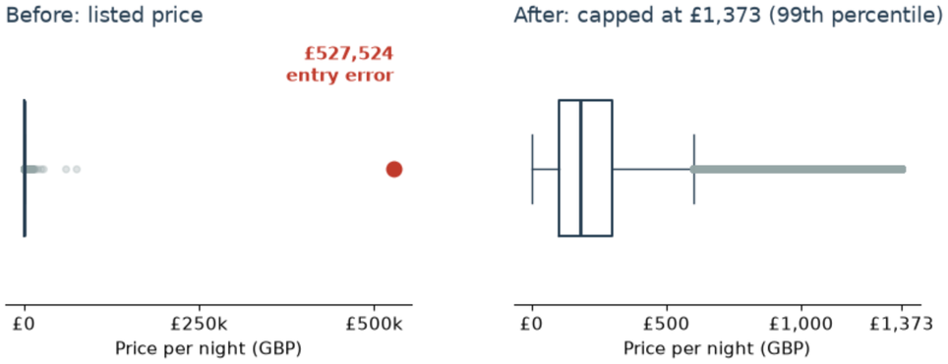
Data cleaning
4 DECISIONS, EACH WITH A REASON
1
DROP
2
CONVERT
3
CAP
4
FILL + FLAG
ISSUE
14 columns 100% empty
Price stored as text ("$127.00")
£527,524 price; rating 0; 2,147,483,647 nights
Missing price, beds, bedrooms, bathrooms
DECISION
Dropped
Converted to a number
Capped at £1,373 (new column); placeholders → missing
Room-type median + "missing" flag
BECAUSE
No values in this snapshot
Text cannot be charted or modelled
Entry errors and placeholders, not real values
Skewed values; missingness linked to rating
BEFORE AND AFTER
THE OUTLIER £527,524
One night, an entry error. 623 prices capped; no rated listing deleted.
CHALLENGE
33% of prices missing; 87% of those can't be booked: a pattern, not random.
Result: 92,635 × 80 · 7/7 checks pass
Notes:
"We made four decisions, each with a reason. Read across the circles."
Drop: "14 columns were completely empty, so we dropped them."
Convert: "Price was text with a dollar sign, so we converted it to a number."
Cap: point at the figure. "One listing claimed £527,524 a night, an entry error. We capped the top 1%, 623 prices, at £1,373 in a new column, so no rated listing was deleted."
Fill + flag: "Missing sizes and prices got the room-type median plus a flag, because missingness itself is linked to the rating."
Challenge: "Price is missing for a third of listings, and 87% of those can't be booked. So it's a pattern, not random."
Result: "After cleaning: 92,635 rows by 80 columns, and all 7 automated checks pass."
Hand-off: "Now Ngoc will show what the data looks like."

Slide 7
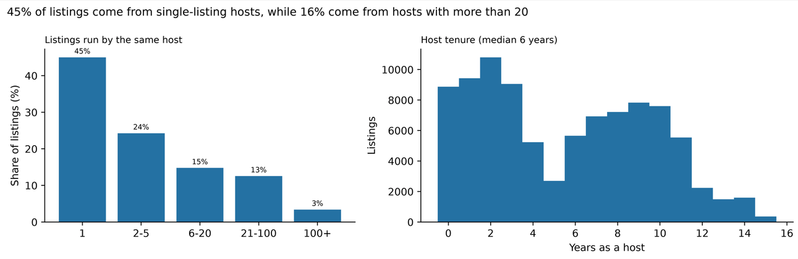
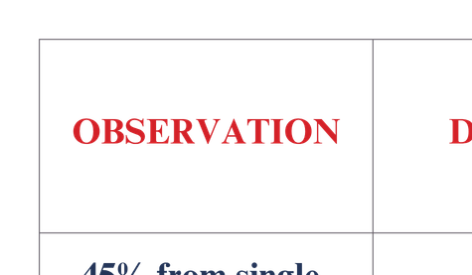
Univariate overview : Host Profile
WHO IS BEHIND LONDON'S AIRBNBS?
TAKEAWAY
London’s host landscape is diverse: from single-listing hosts to large-scale operators.
This makes portfolio size + host tenure worth testing against ratings.

Slide 8

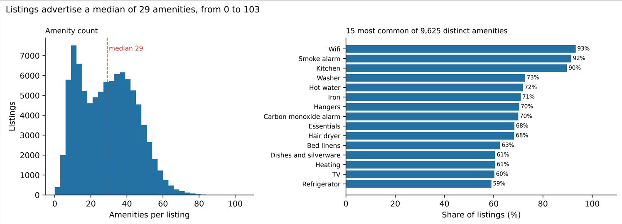
Univariate overview: Listing Amenities
WHAT DO LONDON AIRBNBS OFFER?
TAKEAWAY
London listings vary substantially in amenity count, while basic amenities are nearly universal.
Amenity quantity and differentiating amenities move forward to rating analysis.

Slide 9
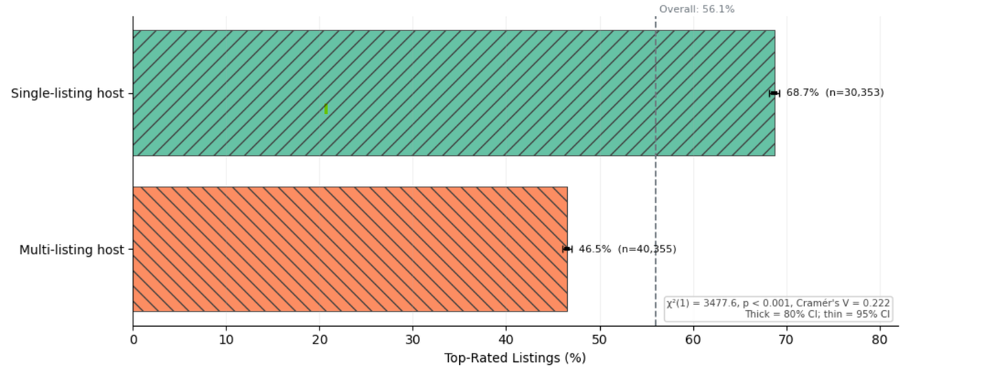
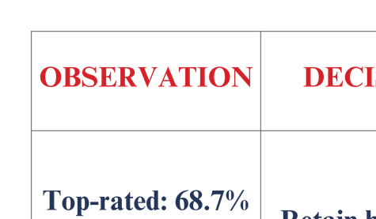
Bivariate overview: Host Profile
DOES HOSTING MORE LISTINGS MEAN BETTER RATINGS?
TAKEAWAY
Single-listing hosts show a 22.2 percentage-point higher top-rated rate.
Host type is our strongest categorical bivariate signal.
Notes:
“Now that we've understood the overall listings, let's see what separates top-rated Airbnbs.
Our first finding is about host portfolio size. **Single-listing hosts have a 68.7% top-rated rate, compared with 46.5% for multi-listing hosts.**
That's a 22.2 percentage-point difference.
With a Cramér's V of 0.222, host type shows the strongest categorical association in our bivariate analysis.
What is Cramer's V - it is the strength of association between 2 categorical variables.
So we decided to carry host portfolio size into our multivariate analysis.”

Slide 10
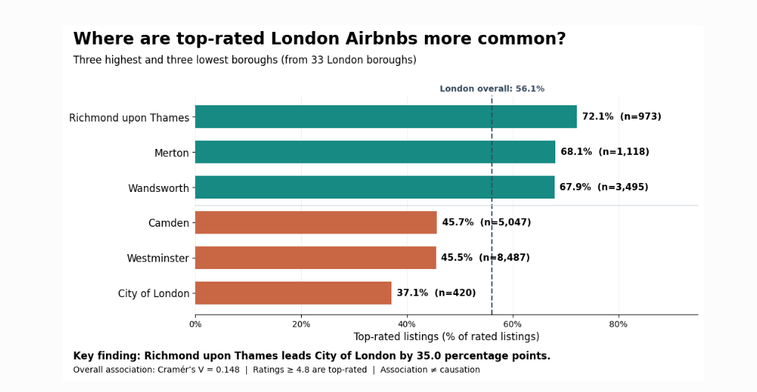

Bivariate overview: Location
DOES LOCATION INFLUENCE THE GUEST EXPERIENCE?
TAKEAWAY
Top-rated performance varies widely across London boroughs.
Location matters, but host type remains the stronger signal.
Notes:
“Next, we examined location across London's 33 boroughs.
We found substantial variation. Richmond upon Thames had a 72.1% top-rated rate, while the City of London had only 37.1%.
Cramér's V was 0.148, indicating a meaningful but weaker association than host type.
So location is another feature we retained for further analysis.”

Slide 11
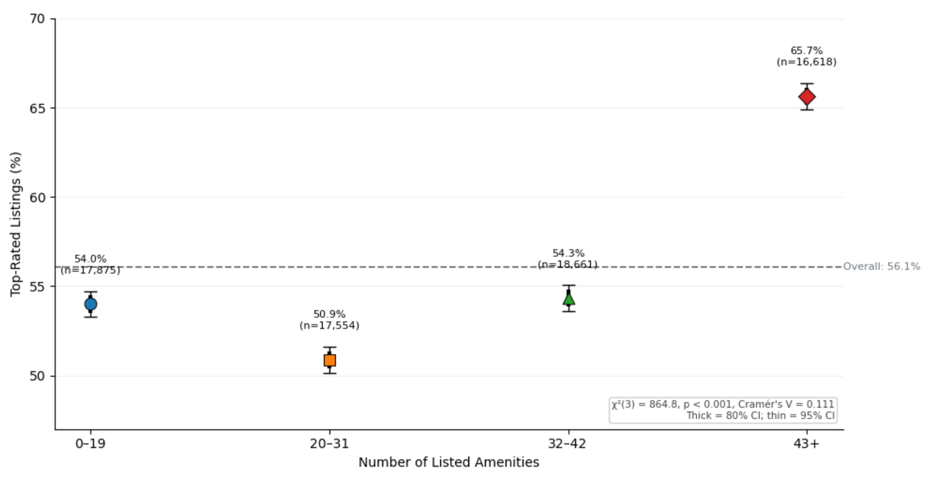

Bivariate overview: Amenity
WHICH LISTING FEATURES MOVE WITH RATINGS?
TAKEAWAY
Amenity-rich listings (43+) show the highest top-rated rate at 65.7%. Amenities matter, but their signal is weaker than host type and location.
Notes:
“We also examined whether amenity count relates to top-rated status.
Listings with 43 or more amenities had the highest top-rated rate at 65.7%, compared with approximately 51 to 54% for listings in the lower amenity groups.
The association was weaker than host type and location, but still meaningful.
We therefore retained amenity count for multivariate analysis.”
Because quartiles aim to create groups with approximately equal numbers of listings, not equal numerical widths.

Slide 12
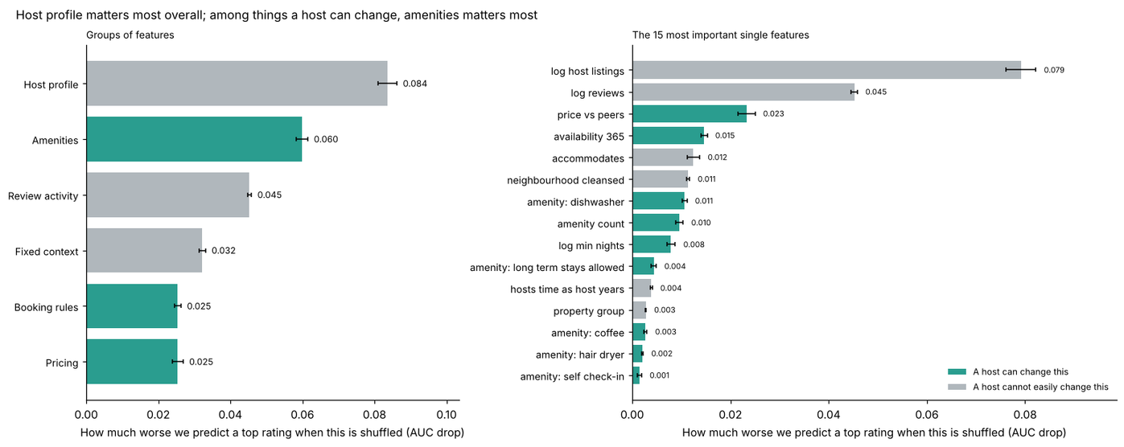
Multivariate overview: Combined Signals
WHAT HAPPENS WHEN WE CONNECT THE SIGNALS?
OBSERVATION | DECISION
Host profile has the largest grouped importance (0.084) | Keep host profile as key context
Amenities lead host-controllable factors (0.060) | Prioritize amenities in host recommendations
Host-type gap persists in 32 of 33 boroughs | Keep host type + location together
TAKEAWAY
No single feature predicts a top rating (none above ρ = 0.28), but together they reach AUC 0.770.
Host profile matters most, while amenities are the strongest factor hosts can change.

Slide 13
Preliminary ML direction
CAN WE PREDICT WHAT DRIVES SUCCESS?
TARGET | INPUT SIGNALS | MODEL PLAN
Top rated ≥ 4.8 (1) | Host profile | Logistic regression (baseline)
Not top rated < 4.8 (0) | Location (borough) | Random forest
70,708 rated listings | Listing + amenities | Compare on validation set
56.1% top rated | Booking rules + pricing | Final check on test set
ML TASK: BINARY CLASSIFICATION
Why, from our EDA:
Ratings pile up near 5.0, so we predict top rated: yes or no
56/44 balance, so no resampling needed
Combined features beat a straight-line rule (AUC 0.770 vs 0.725), so we compare with a tree model
Review sub-scores and superhost excluded (target leakage)
MODELING DECISION
Stratified 70/15/15 split | Preprocessing fit on training rows only | Compare F1, ROC-AUC and confusion matrix
TAKEAWAY
EDA identified the signals; ML tests how well they predict top-rated status together.
Notes:
Bridge: "EDA told us which signals matter. Now: can they predict a top rating together?"
Task: "This is a binary classification task: top rated, 4.8 or above, versus not."
Why classification: "Ratings pile up near 5.0, so predicting the exact number isn't useful. A yes/no at 4.8 gives hosts a clear goal."
Why no resampling: "The split is 56/44, balanced enough that we don't need resampling."
Inputs: point at the table. "Host profile, location, listing and amenities, and booking rules and pricing."
Models: "We start with logistic regression as a simple, interpretable baseline. Then we compare it with a random forest, because Priya's analysis showed combined features beat a straight-line rule: AUC 0.770 versus 0.725."
Leakage: "We exclude review sub-scores and superhost status, because they come from the same ratings we're predicting."
Evaluation: "A stratified 70/15/15 split, with preprocessing fit on training rows only, compared on F1, ROC-AUC and the confusion matrix."
Close: "EDA found the signals; the model will test how well they work together."

Slide 14
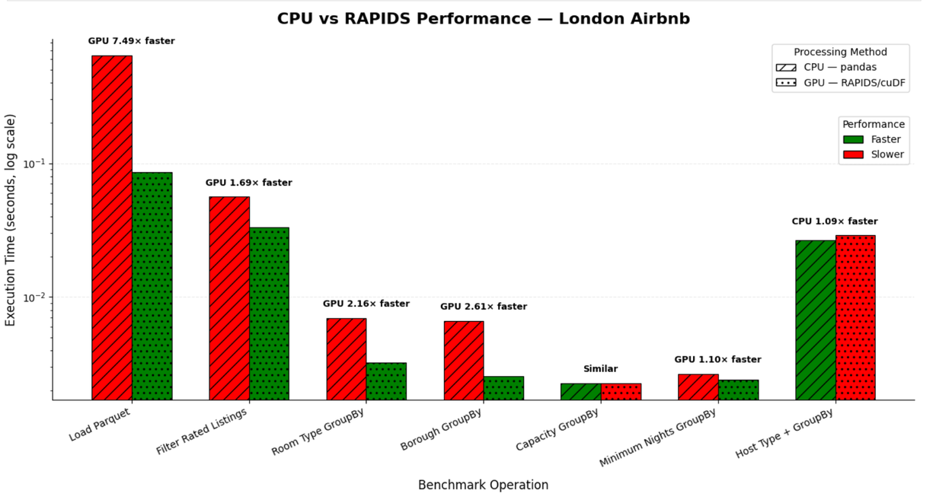
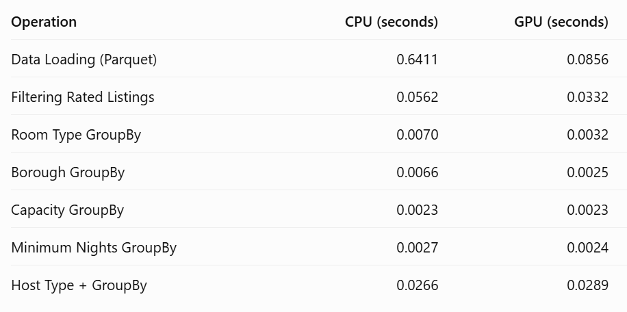
CPU vs GPU (RAPIDS)
DOES GPU ACCELERATION ACTUALLY HELP?
DECISION
Use RAPIDS for data loading and heavier aggregations; retain pandas for lightweight operations.
TAKEAWAY
GPU ≠ always faster. RAPIDS delivers the biggest gains on heavier workloads, while pandas remains competitive on smaller operations.
Notes:
“We also compared pandas on the CPU with RAPIDS cuDF on an NVIDIA T4 GPU.
Using the same cleaned dataset and five-run median timings, RAPIDS was approximately 7.49 times faster for Parquet loading and 2.61 times faster for borough aggregation.
However, for smaller operations, the difference was minimal, and CPU was occasionally faster.
Our conclusion is that GPU acceleration is useful for selected workloads, but not automatically better for every operation.”

Slide 15
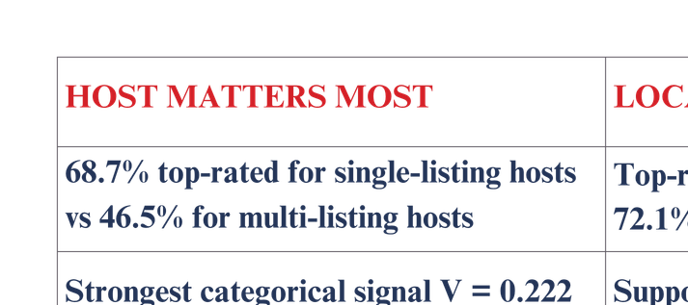
Final synthesis
SO, WHAT MAKES A TOP-RATED AIRBNB?
FINAL MESSAGE:
Top ratings are not driven by one feature. Host profile provides the strongest overall signal, while amenities are the strongest factor hosts can directly change.
Hosts cannot change their location or history but they can improve how their listing competes within that context.

Slide 16
70,708 London Airbnbs
One question. One clear takeaway.
Top-rated success comes from a combination of context and choices,
amenities are the strongest lever hosts can directly control
THANK YOU

